Slide 1
Quality Assurance Measures
Continuous Quality Improvement (CQI) for Rapid and Recency Testing

Slide 2
Content Overview
Understand the importance and components of quality assurance
Identify quality elements throughout RT and RTRI testing
Explain the importance of proper record keeping
Describe the importance of using quality control (QC) specimens
Understand the PT program process
Understand how to ensure proper storage and cycling of stock

Slide 3
Quality Assurance Cycle
QAC
(RTRI Implementation)
Plan
Collect data
Monitor
Corrective Actions
Review & Analyze data
Improve
Develop
Implement
Train testers
Training tools
Data capture tools
On-site Refresher
Provide feedback
Notes:
To ensure quality testing, reporting, pre- and post-testing counseling a quality management system should be implemented. The diagram above shows the steps of quality assurance that should occur in a continuous cycle to implement the quality management system:
Plan/Develop - Planning through engaging leadership, establishing national QA coordination team, defining roles and responsibilities, reviewing and developing QA, financing, and staffing policies
Implement – through training and certification of test providers, site accreditation, supportive supervision, adequate quality/process control, documentation/record-keeping and ensuring a robust supply chain.
Monitor/Feedback/Improve – evaluating quality through post-market surveillance and External Quality Assessment (EQA), using data for decision-making, making improvements, undertaking advocacy and communication, and increasing ownership

Slide 4
Why Is the Quality Assurance Cycle Important?
Ensures that correct test results are provided to client
Provides means to prevent, detect and correct errors
Reduces costs
Even the simplest rapid test is not foolproof!

Slide 5
Components of Quality Assurance
Quality Assurance (QA)
Safety
Quality Control (QC)
Record Keeping
External Quality Assessment
Inventory Management
Proficiency Testing (PT)
Re-testing
Site Visit
Serum Plasma
Dried Tube Specimen (DTS)

Slide 6
Who Is Responsible for Quality?
All test site personnel implementing the procedures
All Quality officers
Q-Corps volunteers
All admin and other staff
All management and program staff who supervise the procedures
Program staff
EVERYONE!
Notes:
Everyone is responsible for quality
Counselors/Lab Techs performing RTRI
Nurses in-charge or other site level managers involved in Recency Surveillance.
District/Regional/National staff who oversee Recency implementation.

Slide 7
Why Do Errors Occur?
Individual responsibilities unclear
Training is not done or not completed
No written procedures or procedures not followed
Checks not done for transcription errors
Test kits not stored properly
QC, EQA not performed

Slide 8
Preventing Errors During 3 Phases Of Testing

Slide 9
Ensuring Accuracy of Test Results
Pre-Testing
Sample collection
Quality Control (Negative, Recent, Long-term)
Record Results
Sample storage
Test kit storage
Testing
Follow testing procedures
Review
Interpretation
Post-Testing
Proper disposal of waste
Report Results
Properly store samples
Sample transport
PPE

Slide 10
Preventing Pre-Testing Errors
Ensure all test kits are stored properly
Review testing procedures
Record kit lot number and expiration date in Result and QC forms
Label test device
Ensure proper specimen collection, transport and storage
Check inventory and expiration dates
Maintain appropriate testing workspace

Slide 11
Preventing Testing Errors
Follow Written Procedures (SOP) and Job aide on Testing and National HIV RT Algorithm and RTRI
Correct volume
Required waiting time
Presence of control line
Trouble-shoot invalid results

Slide 12
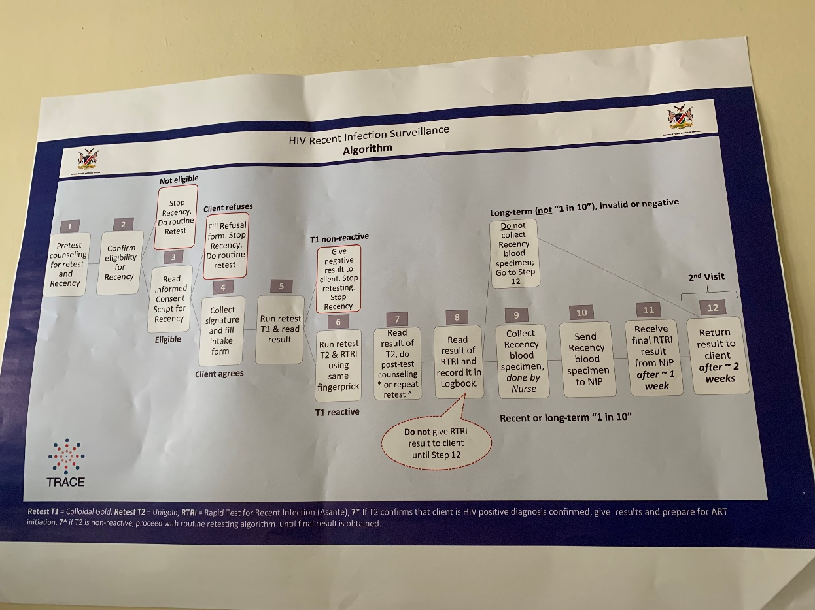
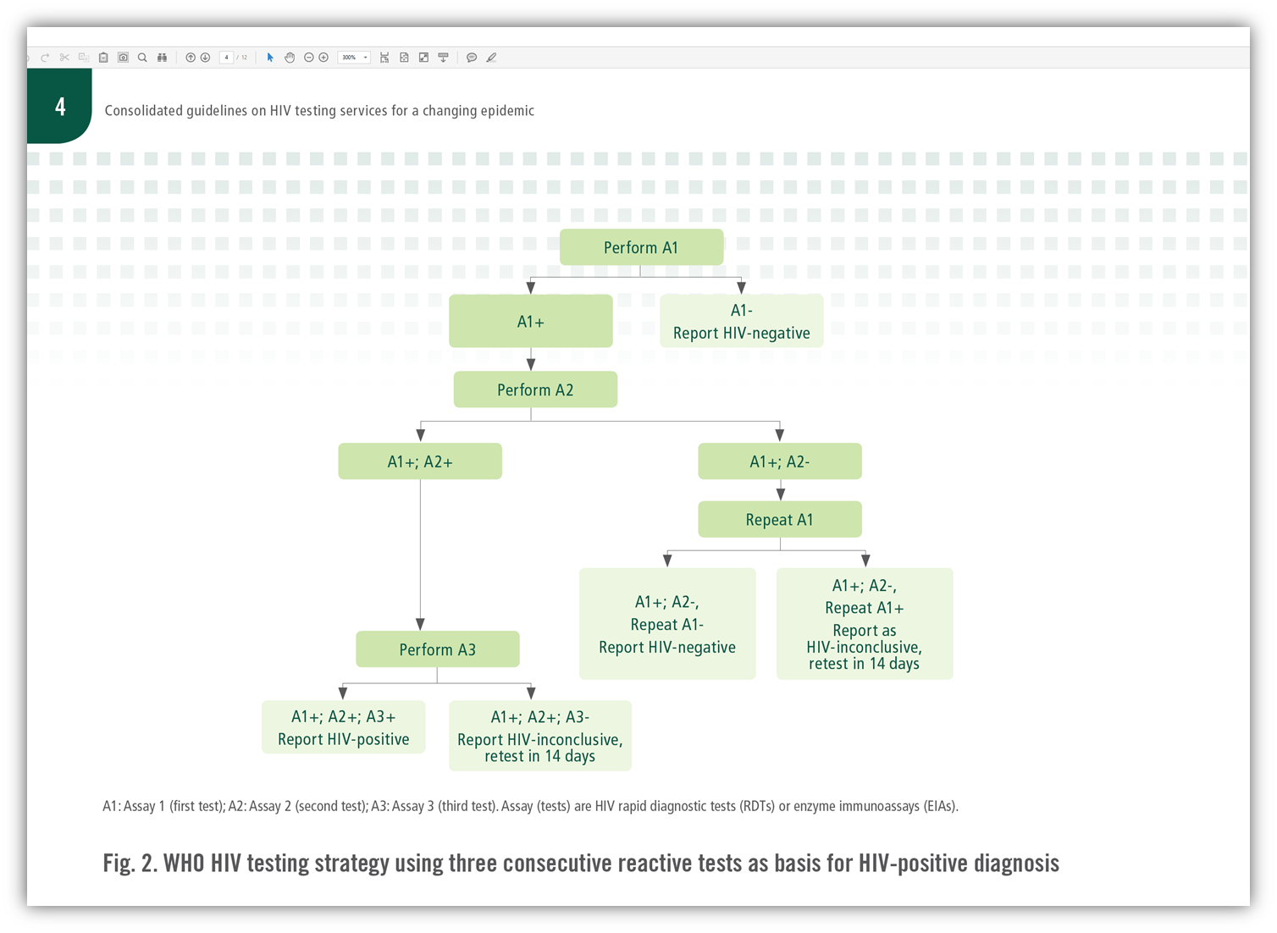
HIV Testing Algorithm
Notes:
Add algorithm picture

Slide 13
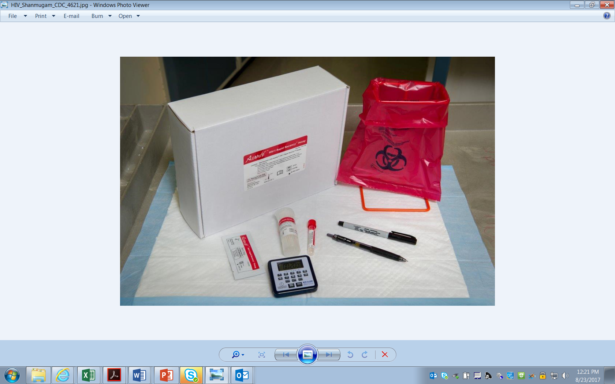

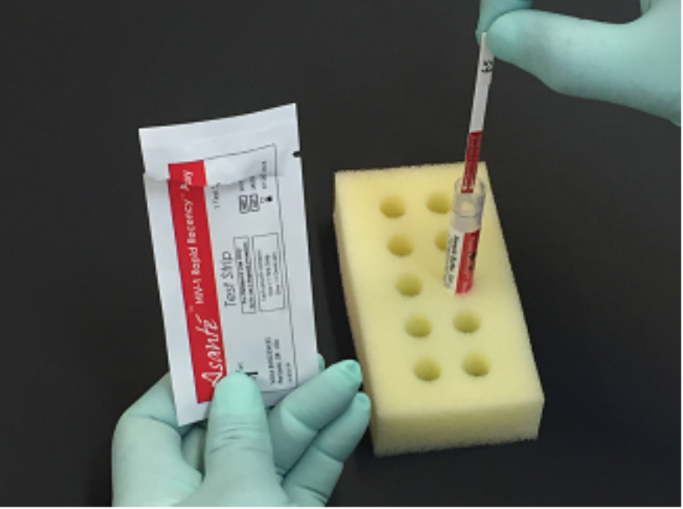
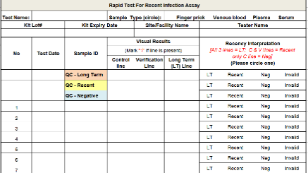
Asante HIV-1 Rapid Test for Recent Infection Job-Aid-Visual
Check kit before use. Use only kit that is not expired or test device not damaged.
If using stored specimens (blood or plasma), bring specimens to room temperature prior to use.
Always use universal safety precautions when handling specimens. Keep work areas clean and organized.
This outline does not replace the product insert or your standard operating procedure (SOP).
Store kit:
2 - 30°C
1
2
3
4
5
6
Collect test items from test kit and assemble other accessories
Label patient or specimen ID number on sample buffer tube. Remove the lid. Discard into a biohazard bag
Remove a specimen collection loop from the vial of loops in the kit
Touch the round end of the loop allowing the specimen to wick up into the loop from the tube or from finger prick
Transfer the loopful of sample directly into the open sample buffer tube. Agitate the loop in the tube to thoroughly mix the sample with sample buffer.
Discard the specimen collection loop into a biohazard bag
7
8
9
10
11
12
Open the foil pouch and remove the test strip.
Insert the Test strip into the liquid in the sample buffer tube with the arrows pointing toward the liquid.
Let the sample buffer tube with test strip stand on a rack.
Start timer and wait for 20 minutes. At the end of 20 minutes remove strip from the sample buffer.
Touch the lower end of the strip to paper towel to drain excess buffer
Lay the strip flat on the bench and read the results immediately
C
LT
Interpretation:
C= Control Line
V= Verification Line
LT= Long Term Line
Long Term= all three lines (C, V, and LT)
Recent = Lines C and V only
Negative = C only
Invalid results = No C line or lines C & LT without V
C
LT
V
13
V
Invalid
Long term
Invalid
Recent
Invalid
Negative
Invalid
Record results
Invalid
Notes:
Emphasize that this is to be used at site of testing, the testing bible for quick reference

Slide 14
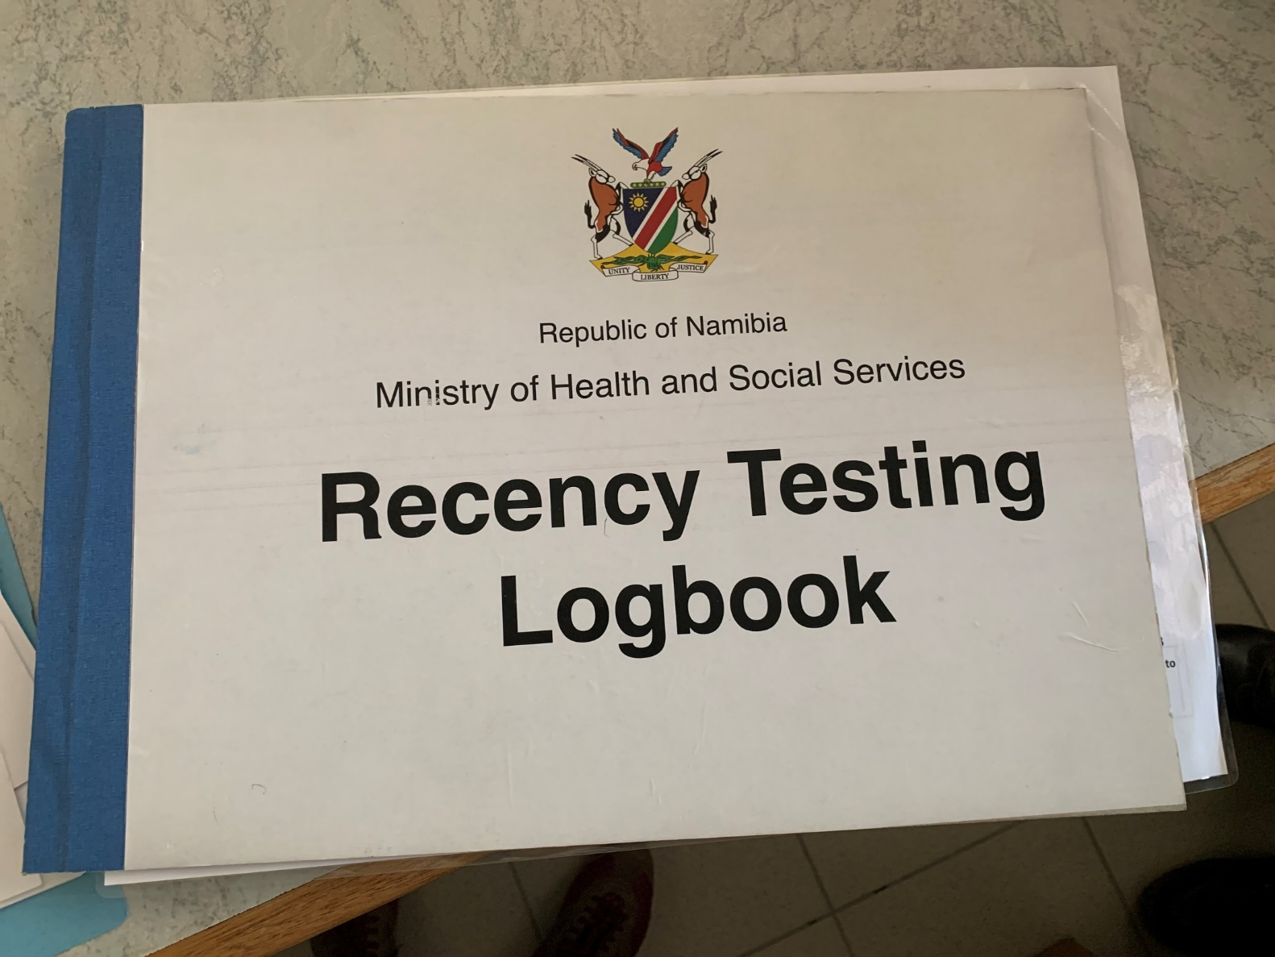
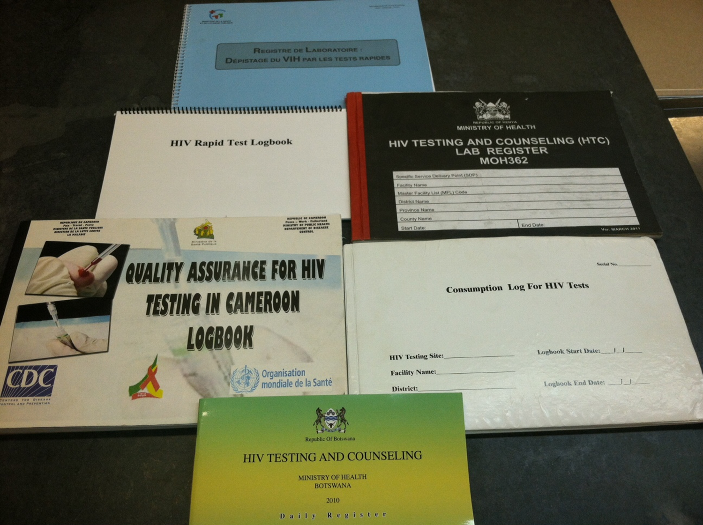
Preventing Post - Testing Errors
Ensure test results are recorded accurately and clearly
Follow standards for recording test results
Periodic supervisor review should be conducted

Slide 15
Comprehensive Training And Competency

Slide 16
RT and RTRI Training Components
Comprehensive training package
Activity-based curriculum
Covers keys areas of quality assurance of RT and RTRI
Hands on practicals
RT
Quality controls (2QCs) and training panels (5 specimens)
Mixture of positive and negative
RTRI
Quality controls (3QCs) and training panels (10 specimens)
Mixture of known LT, recent and negative specimens
Certification of testers – competency assessment criteria
Written examination – 80%
Competency panel – 100%

Slide 17
Multi-Tiered and Systematic Training Approach
Pre-TOT
1. Didactic
2. Lab Practical
High Level Lab Professional
TOT
1. Didactic
2. Lab Practical
Lab Professional
Stepdown
1. Didactic
2. Lab Practical
Lay Tester

Slide 18
Training Package Content for Recency
1
2
3
Overview of Rapid Test for Recent Infection
Quality Assurance Cycle for RTRI
Safety at HIV Testing Sites
4
5
6
7
Specimen Collection, Storage, Handling and RTRI Stepwise Procedure
Recent Infection Testing Algorithm (RITA)
Record Keeping – HTS Register
Professional Ethics
8
Lab Tools and Resources
Notes:
Notes, red box indicates they already have system in place and should utilize that system

Slide 19
Record Keeping
HIV Testing and Counseling Register and Recency Testing Logbook

Slide 20
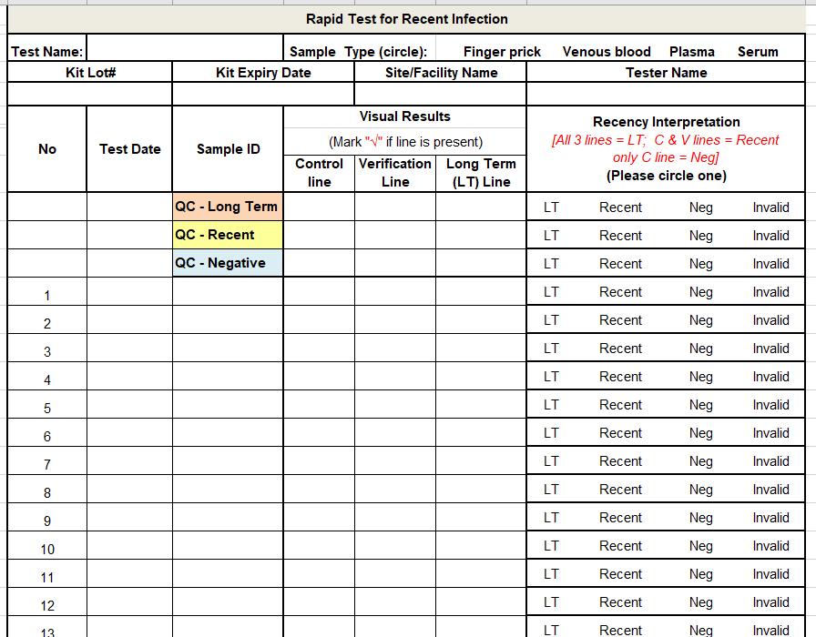
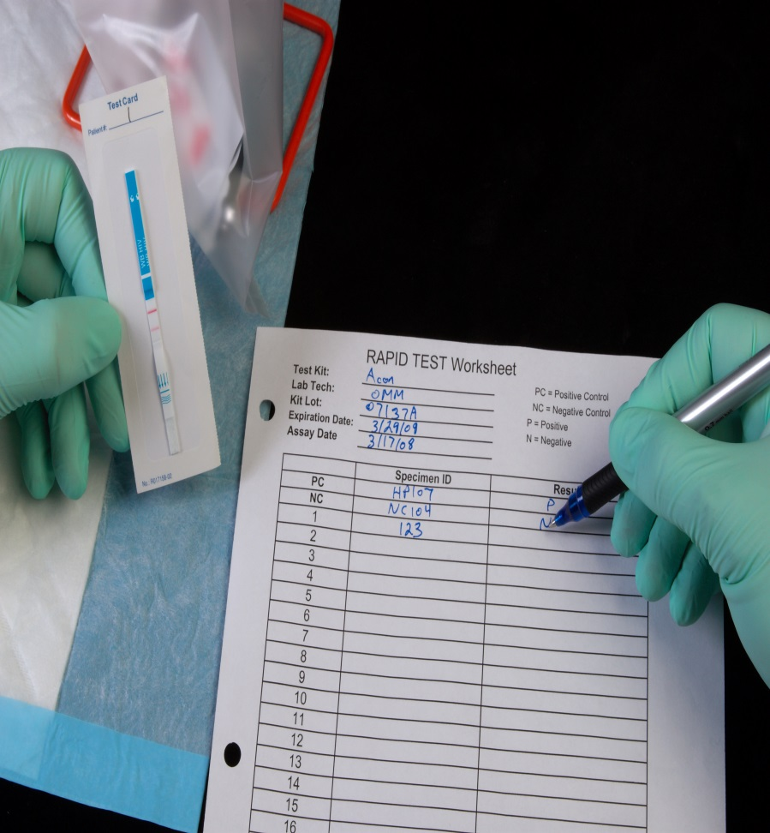
Why is record keeping important?
Maintaining records allows you to:
Accuracy and reliability of testing
Determine areas that need improvement
Assess the validity of the testing algorithm
Provide guidance
Troubleshoot any issues
Compare testing performance across sites

Slide 21
Guide for Good Record Keeping
Understand the information that is being recorded
Ensure all information is recorded every time a procedure is performed
Ensure that all critical information is recorded
Client information
Test kit name, lot number, expiry date
Individual and final test results
Test provider name
Test date
The information is documented the same way every time
Ensure complete confidentiality of clients’ test results by properly storing logbooks and registers that contain HIV-related information
Keep out of view and reach of unauthorized individuals such as other clients and staff
Keep in a locked cabinet when not in use
Archive properly old registers and other testing documents

Slide 22
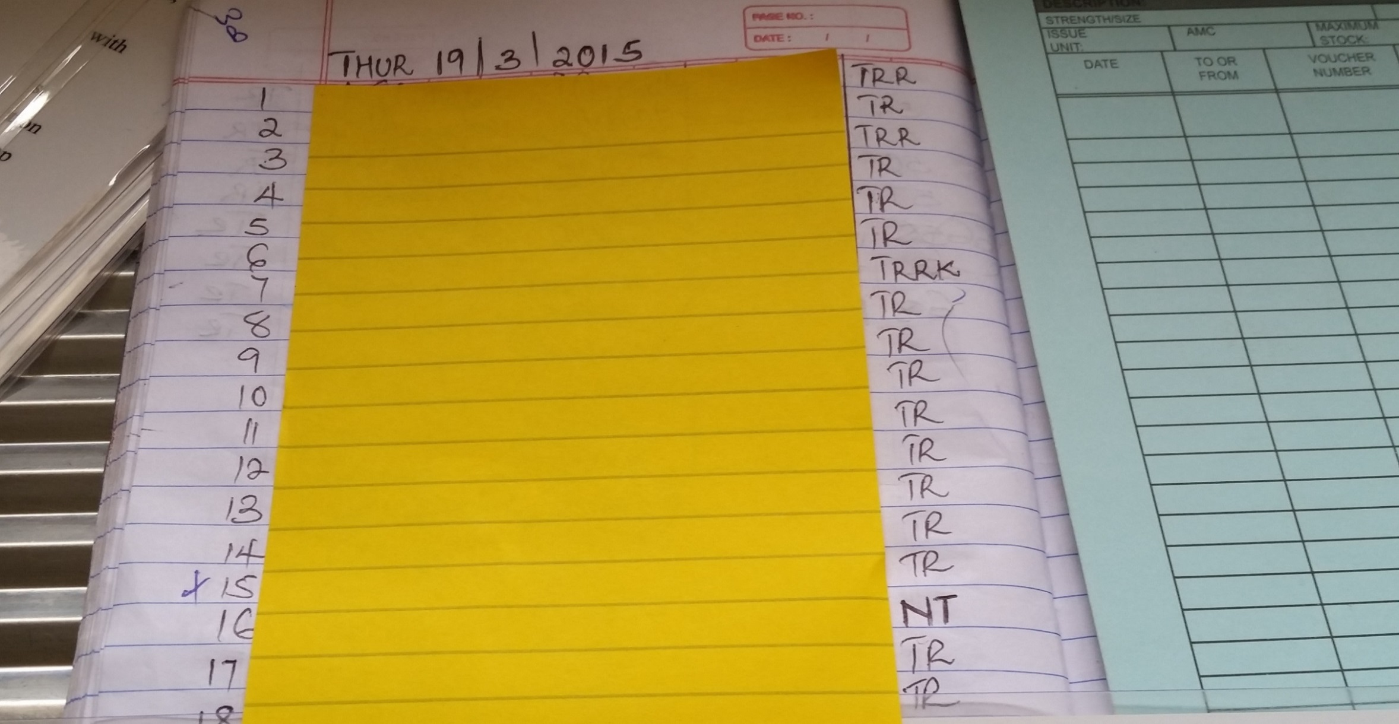
Example of Poor Record Keeping
HIV positive
HIV positive (repeat tester)
Clients’ name recorded in register
HIV negative
Not tested
Notes:
Record keeping at testing sites in the past were:
Often inconsistent or inadequate
Cannot provide key information used to identify problems
Not always standardized

Slide 23
Standardized HTS Test Register
Serves as an ongoing QA tool
Captures all important information
Integrates testing elements
Can help identify problems
Assess the validity of testing algorithm
Forecast based on test kit usage
Notes:
Lecture note to be revised

Slide 24
Example of a standardized HTC register page

Slide 25
Ongoing Assessment of the Quality of HIV Rapid Testing
Same site over time
Different operators
% agreement between test 1 and 2
Different Sites
Testing Algorithm

Slide 26
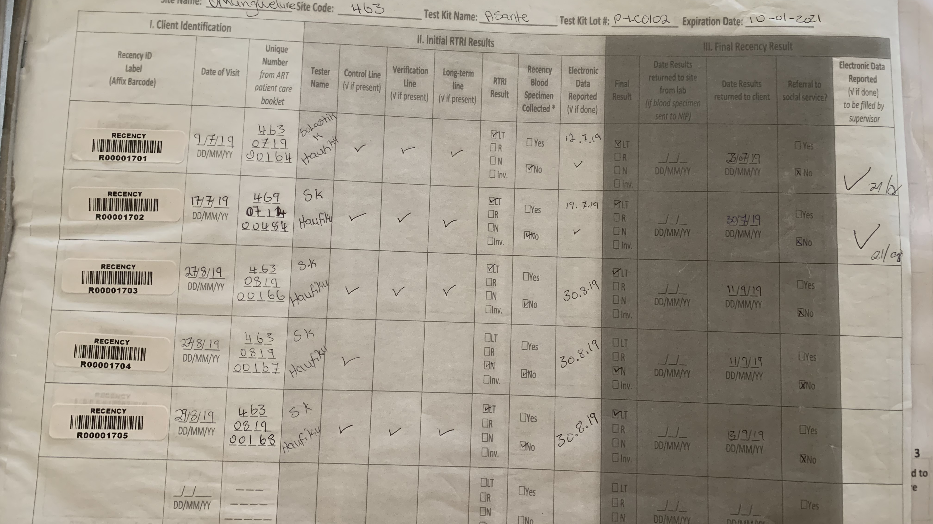
Recency Testing Logbook page

Slide 27
External Quality Controls

Slide 28
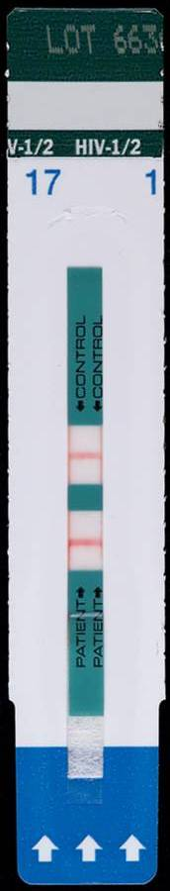
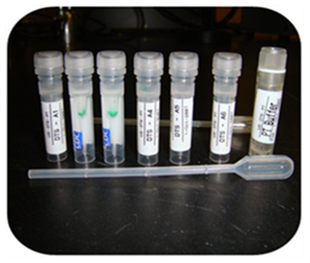
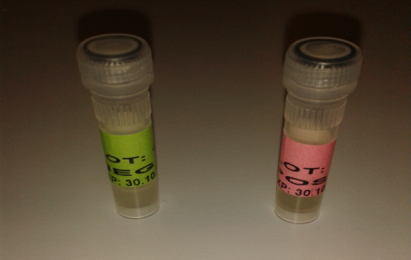
What is Quality Control (QC)?
Measures taken to monitor the quality of the test kit
QC for HIV Rapid Tests and Recency includes:
Internal: Interpreting the presence or absence of control lines within the device itself
External: Testing of samples with known results to verify if the test is working properly
If an error occurs, investigate and know the source of the error
Internal and External QC for HIV Rapid Tests
Internal
Control
External Control
Notes:
Quality control (QC): A mechanism which, when used with or as part of a test system (assay), monitors the analytical performance of that test system (assay). It may monitor the entire test system (assay) or only one aspect of it.

Slide 29
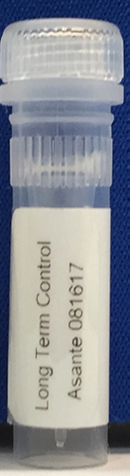
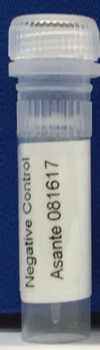
Internal and External Controls in RTRI
Example of Sedia Asante
Internal control as part of testing device
External
Control displaying lot # which in this case is the date of prep
Long Term Control Lot # 081617
Recent Control Lot # 081617
Negative Control Lot # 081617
Internal to the RTRI test strip
Region within the testing device, termed the control line
Must be present for the test to be valid
External to the test Kit
Known samples to ensure performance of kits and continuous competency of tester
Prepared and validated for use with a RTRI test kit
Three QC samples - 1 Negative, 1 Recent 1 Long term

Slide 30
Frequency of Quality Control Runs for RT
Site Level
Minimum once a week, beginning of the week
New shipment of test kits
Beginning a new lot number
Environmental conditions for kit storage exceed temperature range needed for stability of kits (normal range is 2°C-30°C)
QC runs should be rotated in sites where there are multiple testers
NRL
With receipt of new shipment of test kits
At beginning of a new lot of QC specimens

Slide 31
Frequency of Quality Control Runs for RTRI
Site Level
When kit storage conditions exceed range specified by manufacturer (normal range is 2°C-30°C)
If client specimens give a high frequency of invalid or inconclusive results
NRL
With receipt of new shipment of test kits
if there are more than one lot in one shipment, every lot needs to be verified with the QC panel
At beginning of a new lot of QC specimens

Slide 32
QC Testing Instructions for RTRI
QC should be performed at all sites
When kit storage conditions exceed range specified by manufacturer (normal range is 2°C-30°C)
If client specimens give a high frequency of invalid or inconclusive results
Recent, Long term and Negative controls are run at the same time
Record all results on RTRI QC Logbook
Resolve all unexpected results before continuing testing
Completed QC record shall be kept onsite and reviewed periodically by the site lead
Compiled QC data should be sent to NRL

Slide 33
Appropriate use and Storage of Plasma QC Specimens
Remove QC specimens from freezer and thaw at room temperature
Maximum of up to 5 freeze – thaw cycles are allowed
Discard leftover specimens after the 5th thaw
Follow same testing procedure (see job aide)
Once thawed, samples can be kept at 4°C (2°C-8°C) for up to 7 days, discard after 7 days
Dried Tube Specimen (DTS) have been validated for use as an alternative to plasma QC

Slide 34
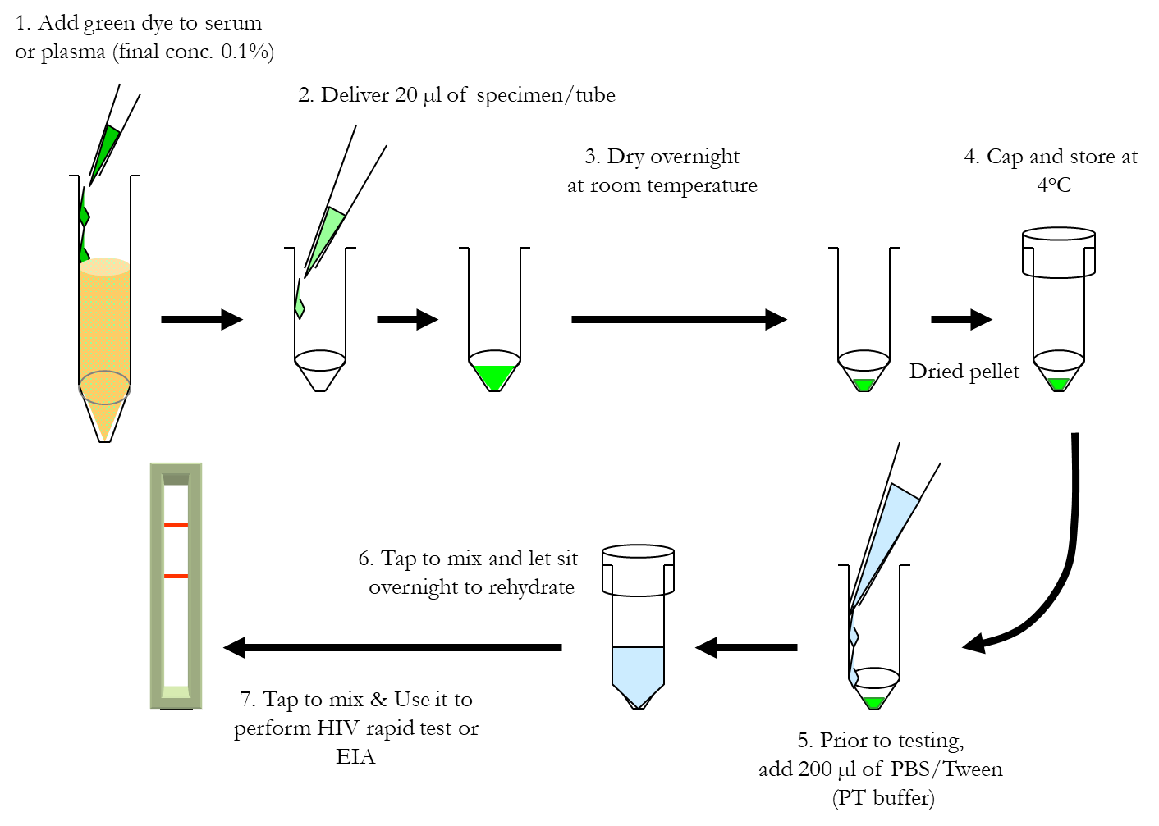
Schematic of DTS Preparation and Testing
RTRI

Slide 35
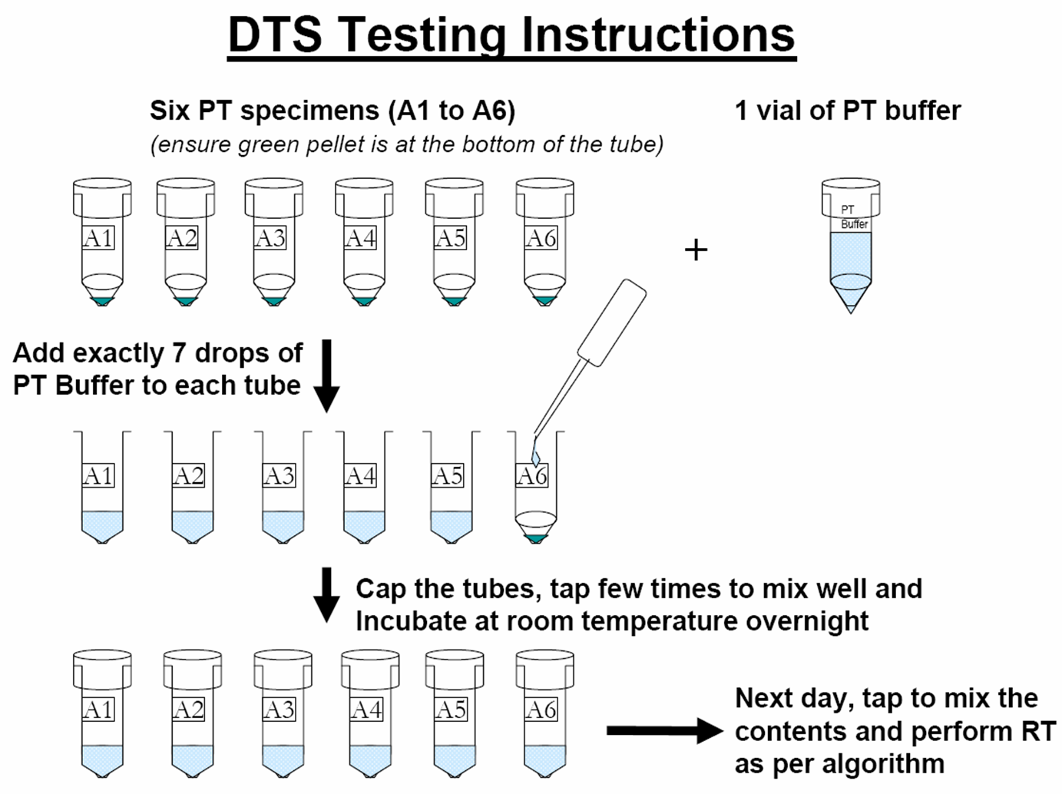
DTS QC Testing Instruction for RT

Slide 36
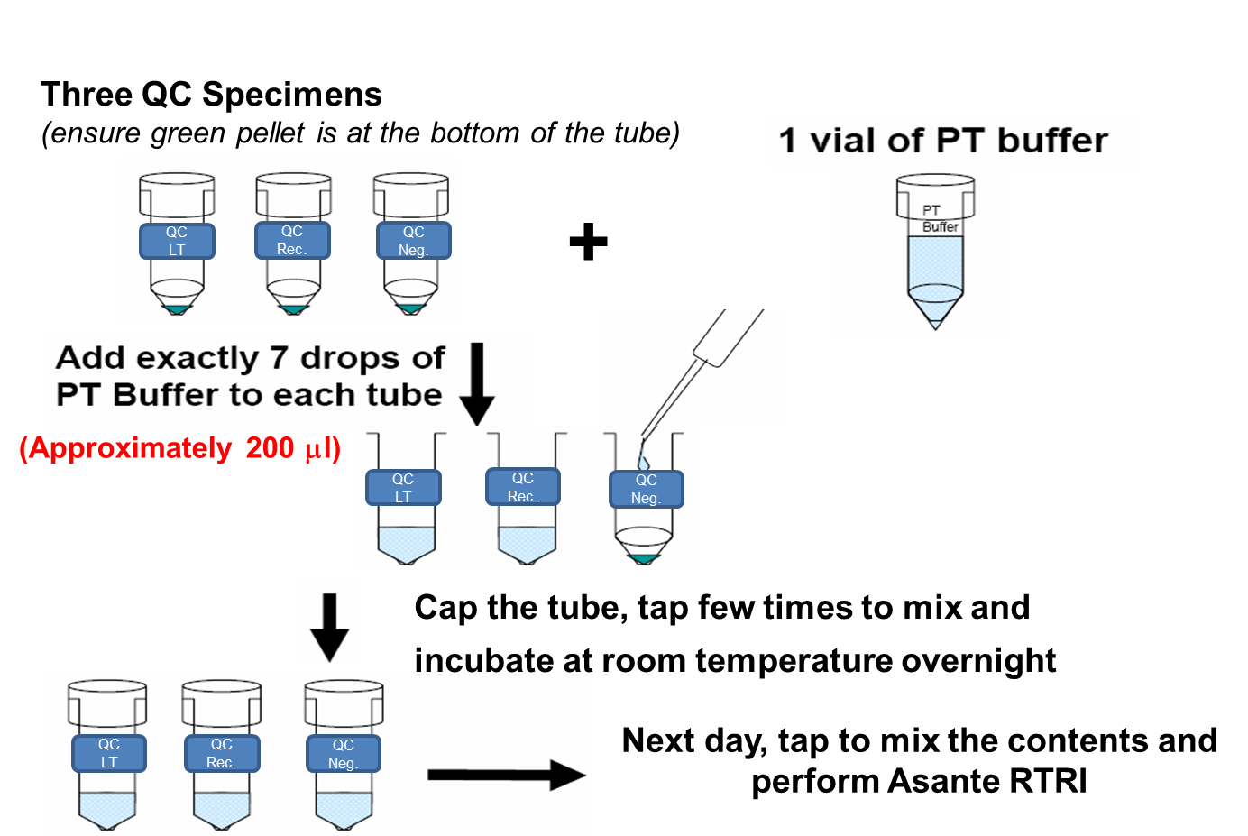
DTS QC Testing Instruction for RTRI

Slide 37
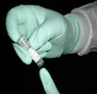

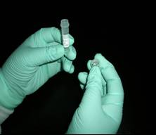
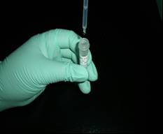
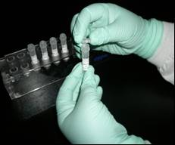

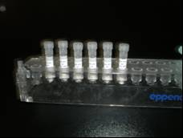

Rehydration of DTS Quality Control Samples Job Aid
Always use universal safety precautions when handling DTS samples.
Do not interchange vial caps. This will lead to cross contamination of samples.
Discard samples once testing is complete.
1
2
3
4
1. Examine the tube. Ensure the green colored dried sample is present and sits at the bottom of the tube.
2. If not, tap the tube until the green sample is visible at the bottom of the tube.
3. Open the tubes only when the sample appears at the bottom.
4. Using plastic pipette, carefully add 7 drops of buffer (PBS with 0.05% Tween 20) to the dried tube samples.
5
6
7
8
5. Cap the tubes.
6. Gently, tap the tubes to mix well.
7. Leave tubes standing upright at room temperature overnight.
8. The next day, tap tubes to mix and test according to testing procedures.

Slide 38
Storage and Handling of DTS QC Specimens for RT
At the lab:
Short-term storage at 4°C
Long-term storage at -20°C or colder up
Stable at room temperature for one month
Overnight rehydration will be done by the health facility tester and the RT performed the next day (see DTS job aid)

Slide 39
Storage and Handling of DTS QC Specimens for RTRI
At the lab:
Short-term storage (12 weeks): store at 4°C
Long-term storage: -20°C or colder up to 2 years and 6 months
Shipped at room temperature and rehydrated upon receipt at the test site
Overnight rehydration will be done by the health facility tester and the RTRI performed the next day (see DTS and Asante job aids)

Slide 40
Maintaining QC Records
Results should be recorded in appropriate QC Logbook and/or HTS register
Review by site supervisor is required
Record all valid and invalid results
For invalid results ensure appropriate follow up and inform supervisor
Document if the invalid result is likely linked to test device, specimen, or tester
A new QC page should be used if the panel lot changes

Slide 41
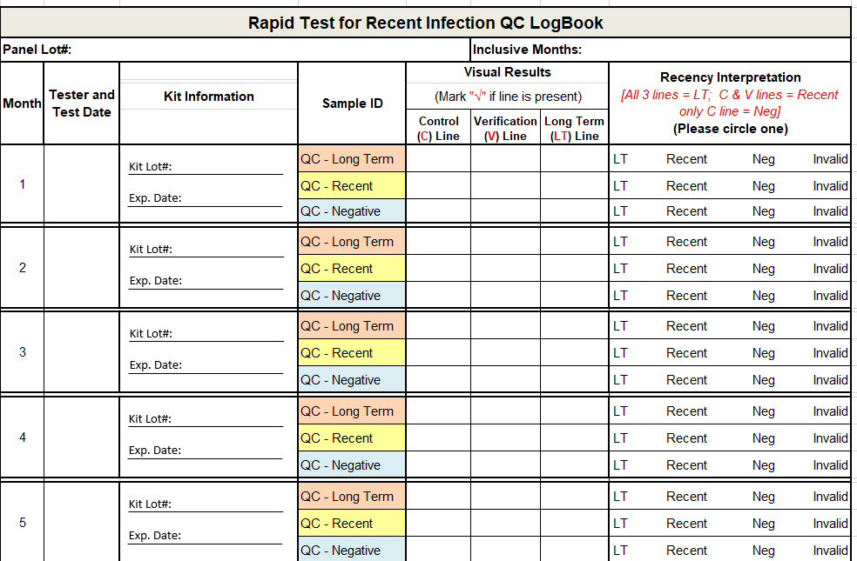
Asante Standard QC Logbook

Slide 42
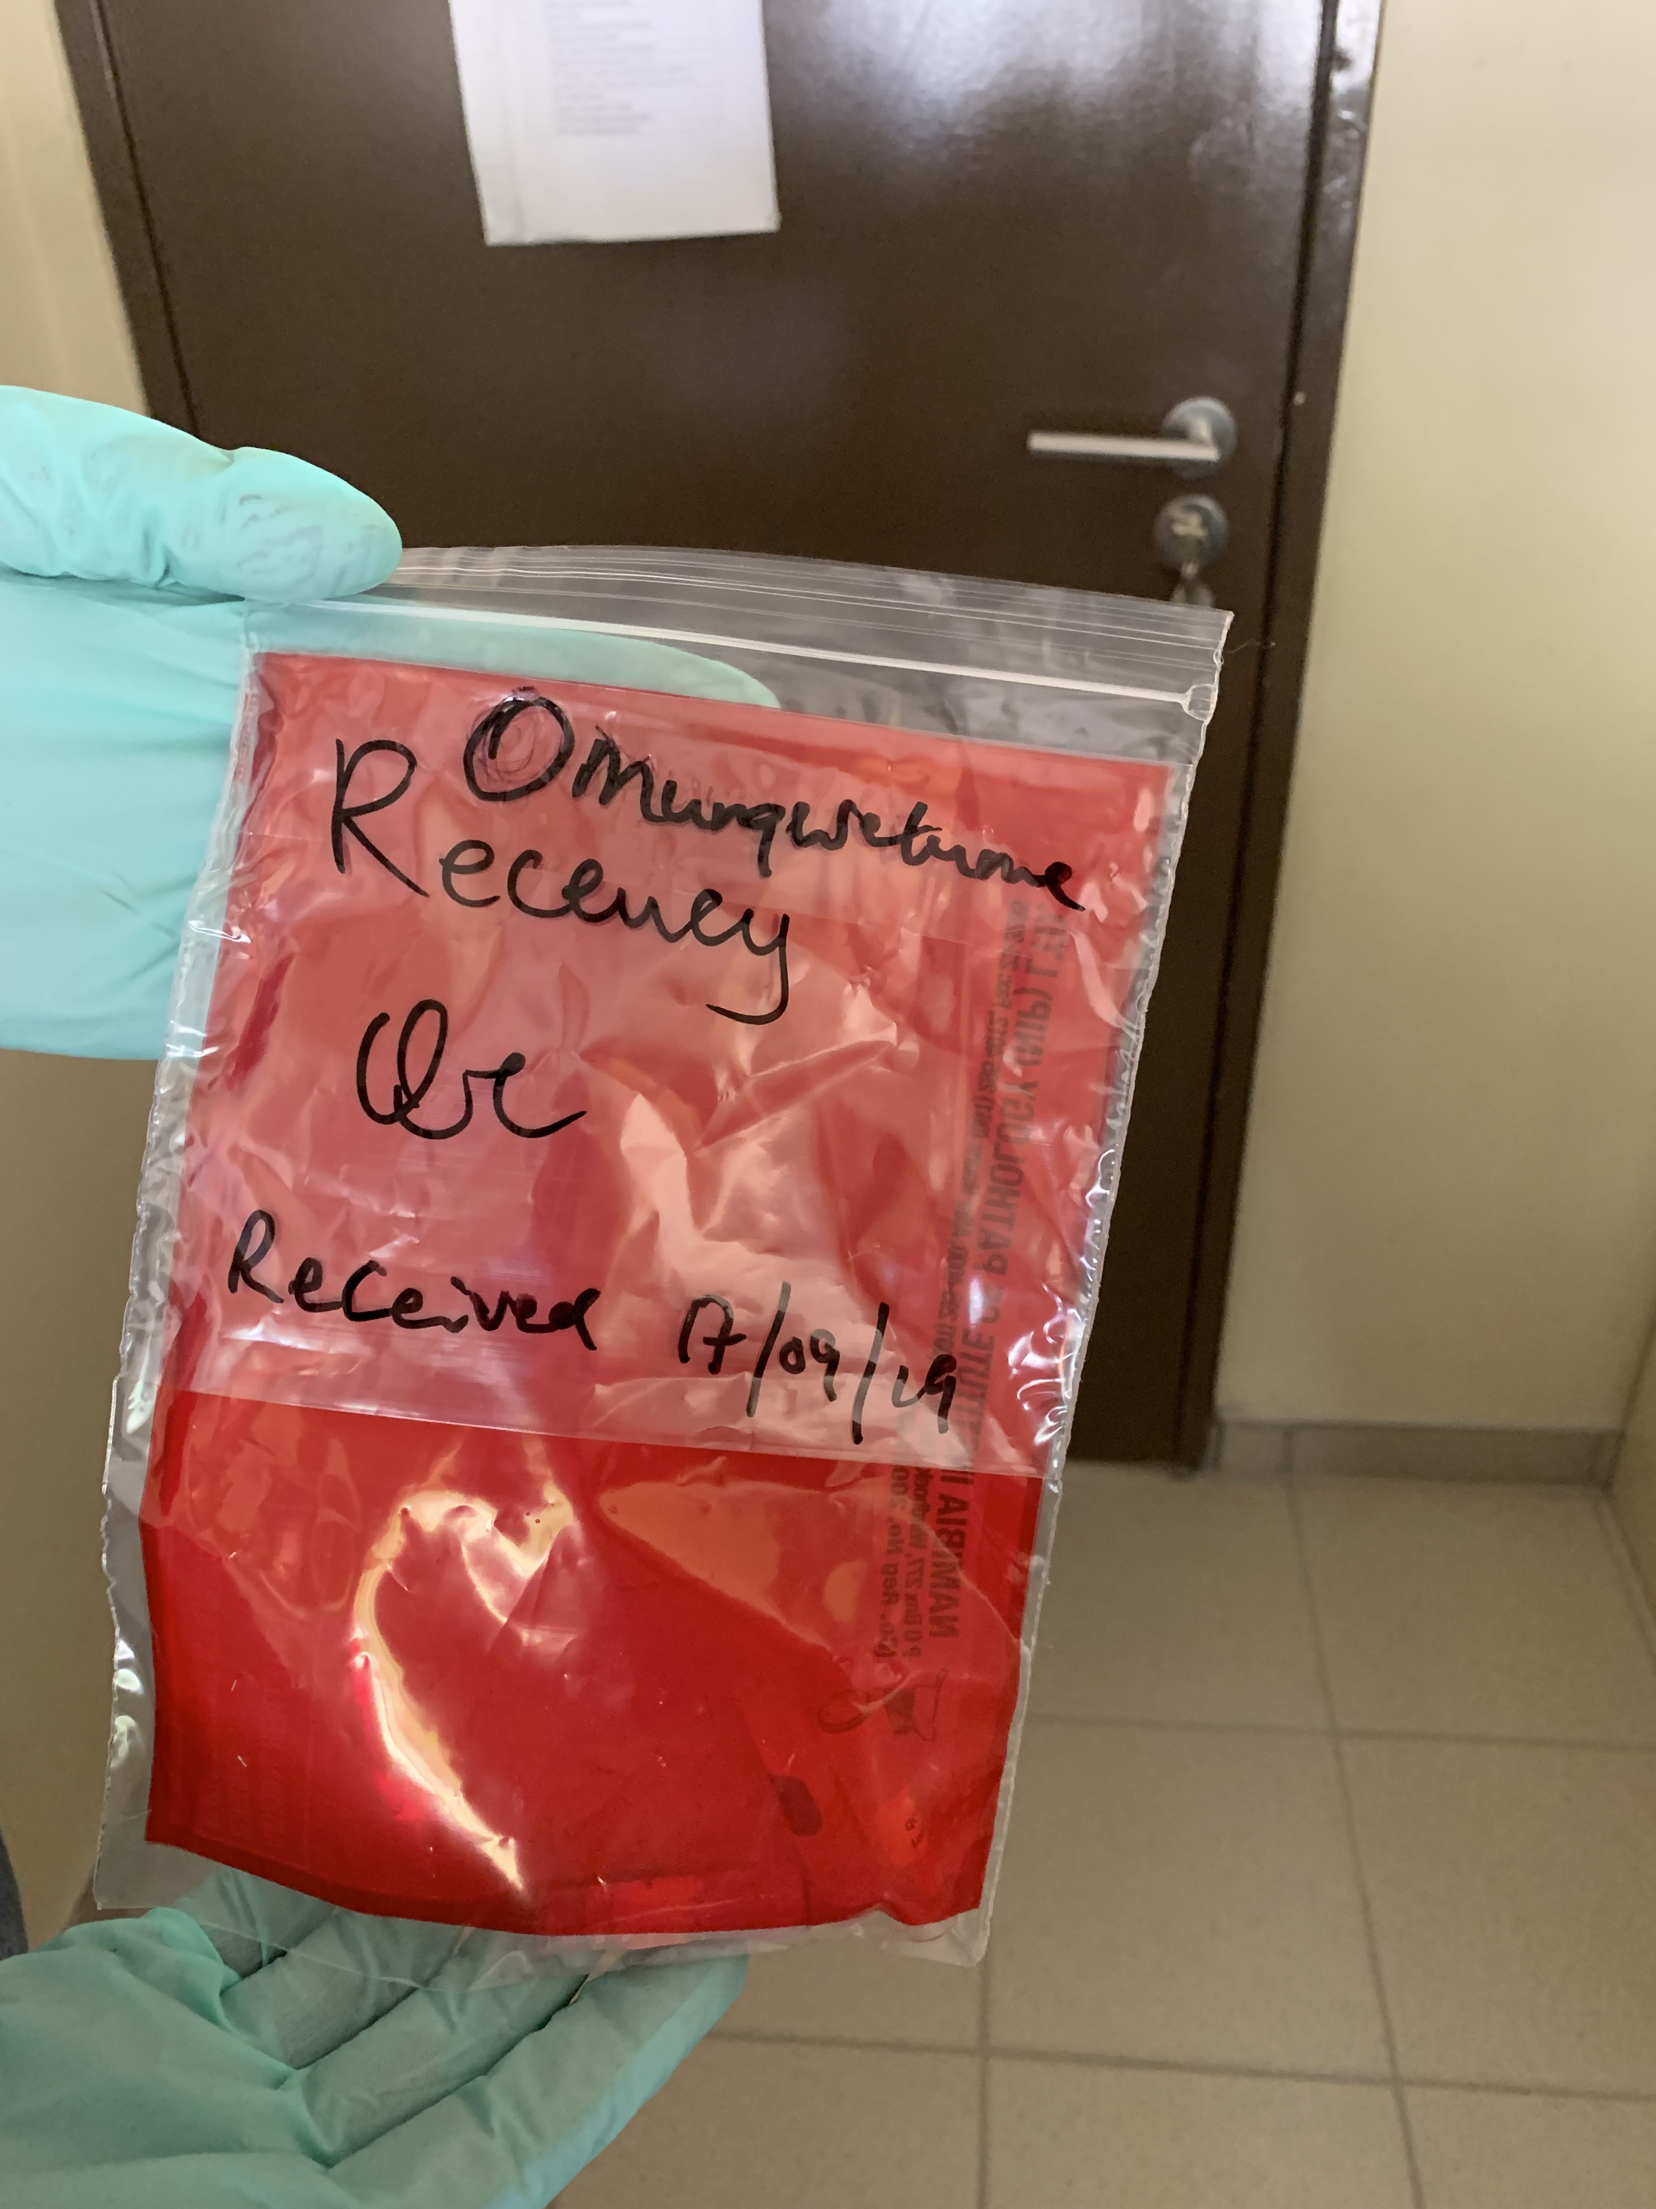
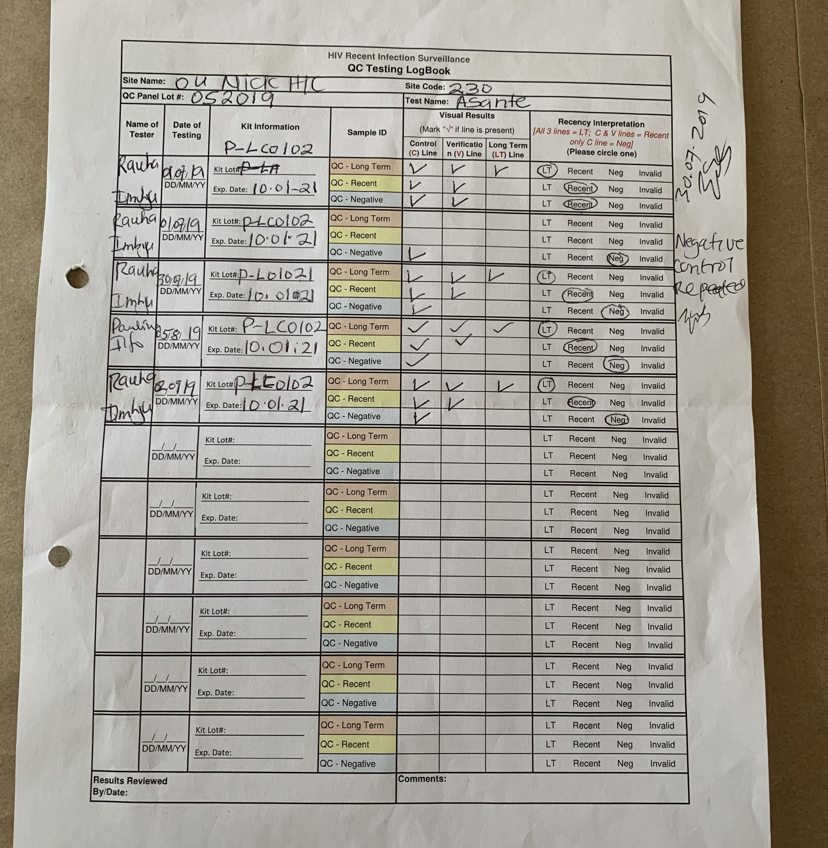
Performing Quality Controls

Slide 43
Invalid QC Results – What Do You Do?
Repeat test using a new strip/cassette
Inform site lead, if invalid again
Take corrective actions
If unable to resolve, contact central Lab
C
V
LT

Slide 44
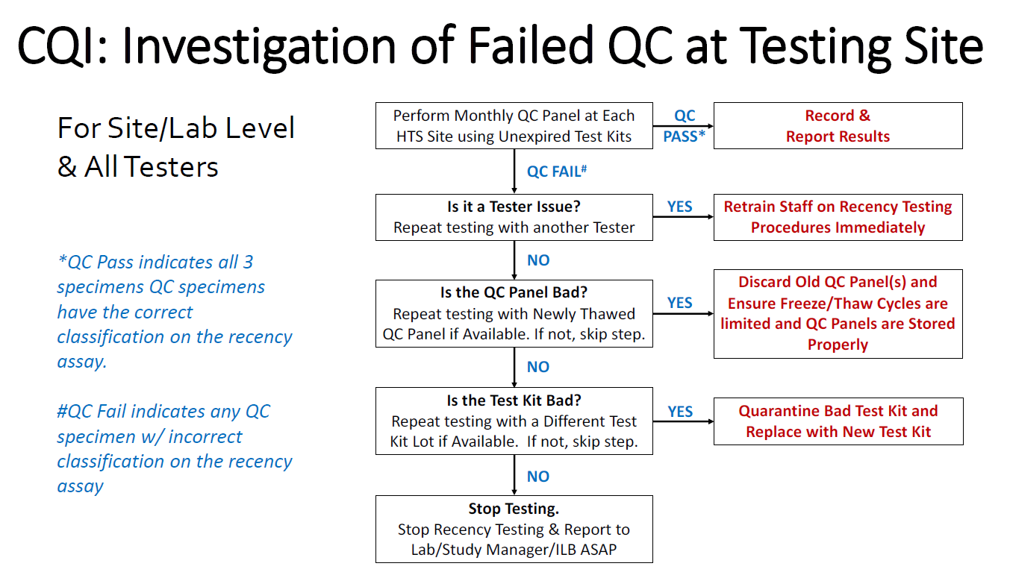
Failed QC Results: What Do you Do?

Slide 45
External Quality Assessment

Slide 46
External Quality Assessment Activities
Site Visits
Proficiency Testing
A team of supervisors assesses testing site and provides feedback report for improvement
Testing of unknown samples received at regular interval by all testing providers
5 or more unknown samples
2 times/year
Supervisory visit
Notes:
Explain the terminology. Additionally, update examples (i.e., support supervisory visit, site visit, site supervision); or every 20th specimens for retesting or number of PT samples and frequency) to reflect current situation in country.
NOTE: Address and remove the note icon on top corner of the slide in applicable

Slide 47
EQA Should Lead to Corrective Actions
EQA
Identify
Problems
Take
Corrective
Action
Corrective action is:
An action taken to correct a problem or deficiency
An action to improve the accuracy of test result
NOT a disciplinary action against the tester

Slide 48
Proficiency Testing Cycle and Frequency
PT Program
Enrollment
Panel Distribution
Results Submitted
Feedback
Data Analysis
Corrective Actions
At least 2x per year
Each tester is responsible for performing the test based on the survey algorithm and report the results within 1 week to the regional/district level
Notes:
Customize this slide in reference to country specific examples where applicable.
Review key features of the country’s PT program.

Slide 49
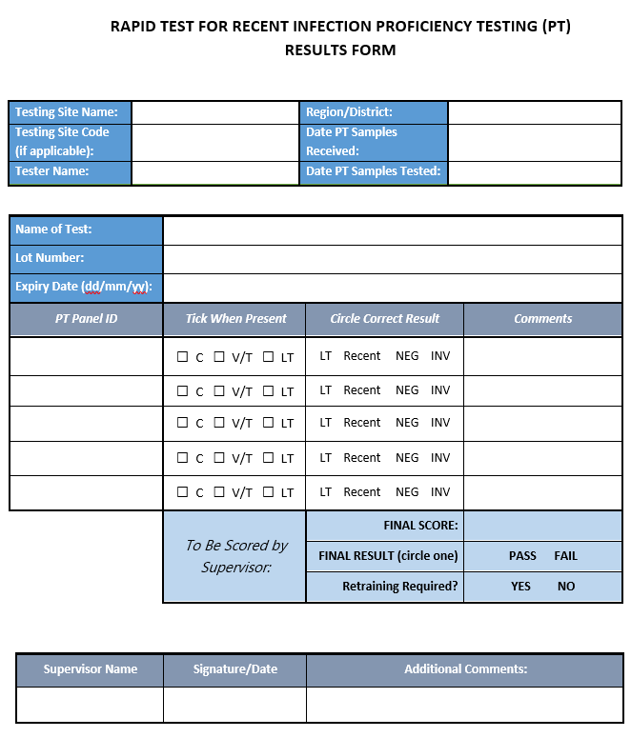
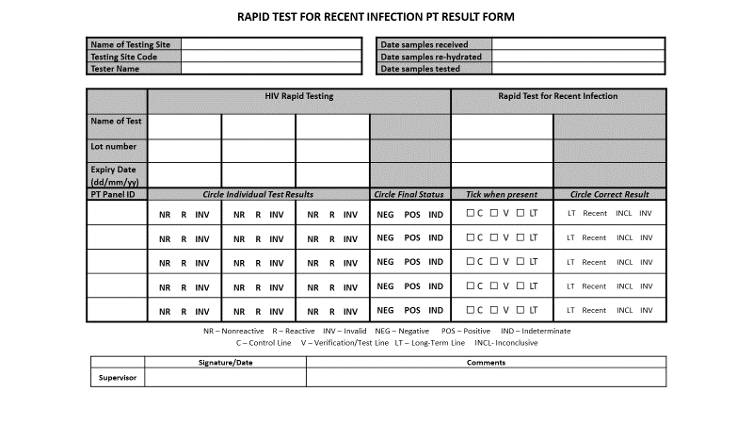
Notes:
Recommendations for integrating RTRI PT into the existing national PT program (reference section 8.5, specifically 8.5.10 Panel Composition) of SOP. The current ILB recommendation is to prepare 1 panel that will be distributed to all HIV testing sites participating in the program. Sites will test the samples using the national HIV Rapid Test algorithm according to the country PT program procedures. Those sites with the capacity for recency testing will additionally characterize those specimens (that are HIV-positive) for recency, and can record Asante results either on a separate form or a combined HIV RT/Asante PT form.

Slide 50
Roles and Responsibilities
National Reference Lab
Testing Site
Regional/District Level
Train testing providers
Provide PT panels
Analyze PT results submitted
Provide timeline feedback to testing sites
Provide guidance for corrective actions
Conduct sites supervision
Verify panel components upon receipt
Test according to country algorithm and RTRI
Submit report within deadline
Report problems with testing
Review feedback report
Implement corrective actions if any
Assist with training of testers
Distribute PT panel packs
Collect PT results forms from sites
Distribute PT feedback report to sites
Assist with providing corrective actions
Assist with site visits
Notes:
Briefly DISCUSS the components of the PT pack.
REMIND participants to process the panel as if it were any other specimen.
STRESS the importance of reporting any problems that may prevent timely return of results.
EXPLAIN the benefits of reviewing the feedback report and the implementation of corrective actions.

Slide 51
Stock Management and Inventory

Slide 52
Stock Management Tasks
Perform a “stock count” and maintain proper inventory records
Ensure proper storage and cycling of stock
Check quality of stored supplies periodically
Decide when and how much to re-order
Inspect incoming orders
Submit list of needs to management

Slide 53
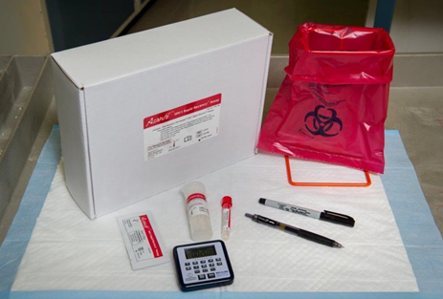
Inspect Delivery of New Orders
Record date received and who received it
Inspect Integrity of the supplies (damaged, expired etc.)
Check to make sure you have received the right order
Store supplies according to expiration dates – “First Expiry, First Used”
Example showing Asante Test Kit and components

Slide 54
Stock Management Leads to High Quality Testing
Keep in a clean, organized, well-ventilated and secured area
Store according to manufacturer’s instructions
Store away from direct sunlight
Organize supplies by expiration dates so that older supplies are used first
Ensures availability of materials and kits when needed
Ensures expired kits are not used
Minimizes wastage

Slide 55
Review
What are some steps to take before, during, and after testing to assure the quality of results?
What is the difference between an inconclusive for RTRI and an invalid result?
How often and when should quality controls be used for RT? For RTRI?
What procedure should you follow when receiving new kits and supplies?

Slide 56

Thank You

